Slide 1

COMP150
Robotics Proposal Presentation
Jong Seo Yoon
Timi Dayo-Kayode
Michael Edegware
October 10th, 2017

Slide 2
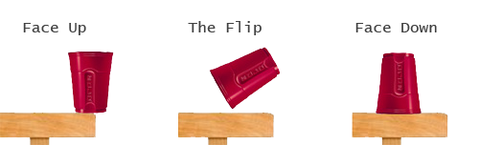
Object Flip Detection
Goal
Question : Can a robot detect irregularity of the state the object is in?
Robot that detects flipped object and returns it back to normal position.
Use of computer vision and other sensors for detection.
Example
Flipped Cup

Slide 3
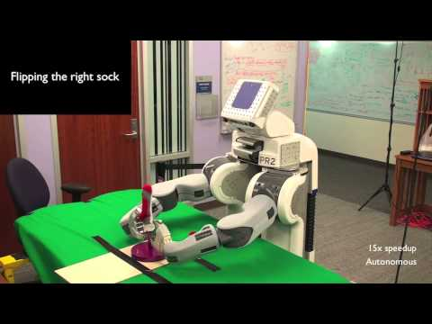
Object Flip Detection
Reading Material
Pin Chuan Wang, Stephen Miller, Mario Fritz, Trevor Darrel, Pieter Abbeel Perception for the Manipulation of Socks http://ieeexplore.ieee.org.ezproxy.library.tufts.edu/document/6095013/

Slide 4
Generalization of Location and Object
Goal
Question : Can an object and the location be generalized for the robot to make an intelligent decision about where the object may be located?
Example : If I tell the robot “Hey robot, go find me a pen”, then the robot goes into the room where the desk is located and searches for a pen, then returns back to me with a pen.
Requires robot’s deep understanding of knowledge of the room in which the object may be located in, as well as what each object looks like(or used for).

Slide 5
Generalization of Location and Object
Living Room
Bathroom
Desk
Robot
Bath Tub

Slide 6
Generalization of Location and Object
Reading Material
Ester Martinez-Martin, Angel P. del Pobil Object Detection and Recognition for Assistive Robots: Experimentation and Implementation http://ieeexplore.ieee.org.ezproxy.library.tufts.edu/document/7885021/
Extract features by colors, motion, shape, memory, and finally recognition.

Slide 7
Obstacle avoiding robot
Goal:
Question: can a robot survive in an extremely mobile environment? How fast and efficient should it move to avoid approaching obstacle(s)?
Example: If a robot senses a fast moving object of size L form direction x, and decides to move to direction y at a speed of Vm/s a distance of L+(1.5*robot*width) just in time to avoid being hit. If for another case, the same object approaches from same direction but with extremely slower speed. Should the robot move with same velocity to avoid being hit? Should it even move? Knowing that the higher the velocity the more the cost.
Robot needs to have a defined square 360 field of vision and will learn which direction it should move to based on it studying other aspect of it’s environment.

Slide 8
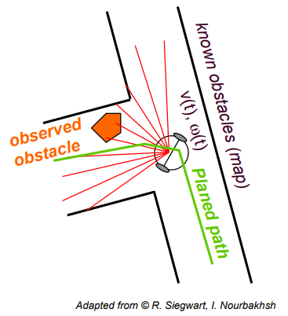
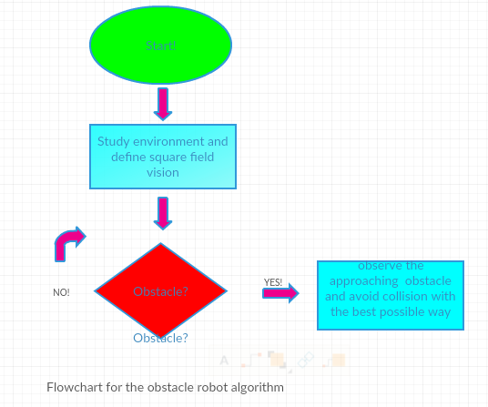
Obstacle avoiding robot

Slide 9
Obstacle avoiding robot
Reading materials:
IOAN SUSNEA, VIOREL MINZU, GRIGORE VASILIU
Simple, Real-Time Obstacle Avoidance Algorithm for Mobile Robots
https://pdfs.semanticscholar.org/519e/790c8477cfb1d1a176e220f010d5ec5b1481.pdf
Sharayu Yogesh Ghangrekar
A PATH PLANNING AND OBSTACLE AVOIDANCE ALGORITHM FOR AN AUTONOMOUS ROBOTIC VEHICLE
https://webpages.uncc.edu/~jmconrad/GradStudents/Thesis_Ghangrekar.pdf

Slide 10
Maze Navigation Optimization
Goal
Question : Can a robot go through a maze in x amount of time and learn the shortest path to go through that maze.
Example : The robot solves a maze using trial and error, saving paths that lead to dead-ends in its memory and knowing not to retry those paths in 15 minutes, but then learns the optimum path to get through the maze and solves it in 5 minutes the next time it tries.
Requires robot’s ability to remember incorrect paths and all possible routes as it navigates its way to the exit and then create a path that goes through the maze more efficiently. Also requires robot to correctly identify a dead end and correctly retrace steps to most recent fork in path that hasn’t been explored.

Slide 11
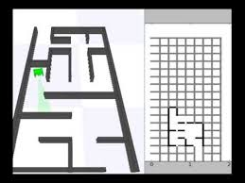
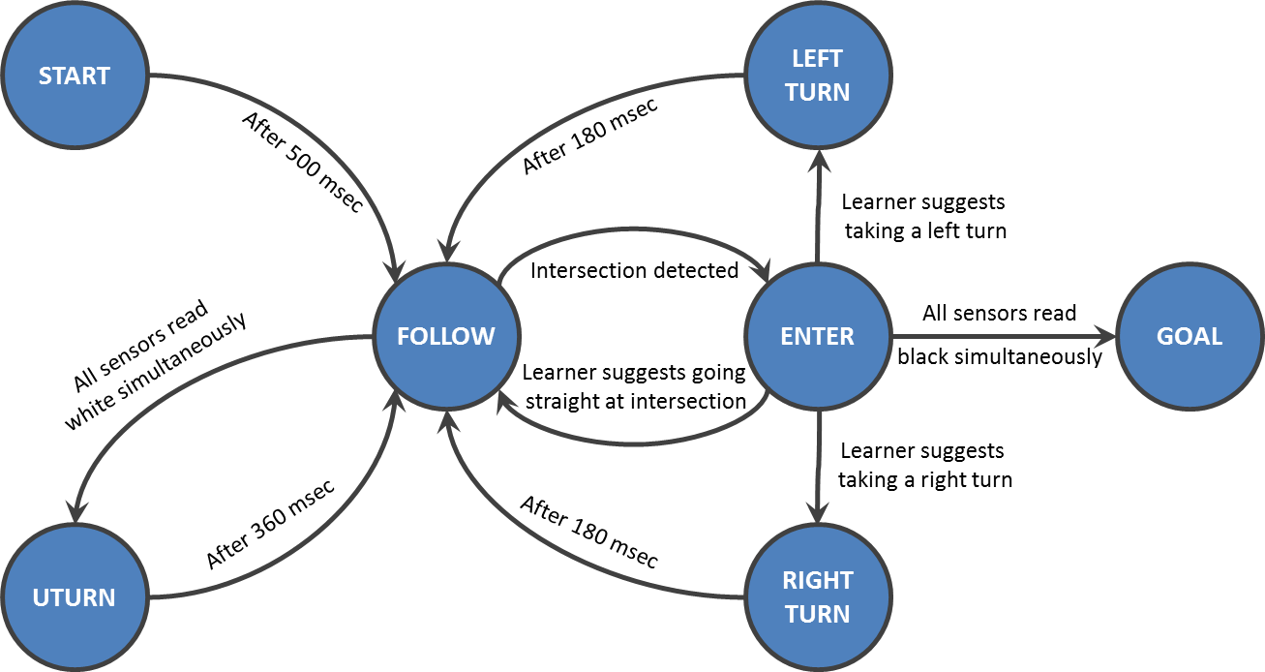
Maze Navigation Optimization

